Slide 1
GENERATING THREE-ADDRESS CODE FOR CONTROL STATEMENTS
Done by
K. Madhusudhan(192210035)
G . Jayanth Kumar Reddy(192211374

Slide 2
TABLE OF CONTENTS
S.NO | TOPICS
1 | Abstract
2 | Introduction
3 | Problem statement
4 | Proposed design 1.Requirements Gathering and Analysis 2.Tools selection criteria 3.Scanning and testing methodology
5 | Functionality 1.Users authentication and role based access control 2. Tool inventory and management. 3. Security and compliance control
6 | UI design 1.Layout design 2. Feasible elements used. 3. Elements positioning and functionality.
7 | Conclusion

Slide 3
ABSTRACT:
This presentation focuses on the generation of Three-Address Code (TAC) for control statements in programming languages. Three-Address Code is an intermediate representation used in compilers and interpreters to translate high-level code into machine code or bytecode.
Control statements such as if-else, loops, and switch-case play a crucial role in program logic and flow control. Generating efficient TAC for these control statements is essential for optimizing program execution and improving code performance.
In this presentation, we explore various techniques and algorithms for generating TAC for control statements, discuss their advantages and limitations, and provide practical examples to illustrate their implementation. By understanding the principles behind TAC generation for control statements, developers can enhance their programming skills and build more efficient and optimized software systems.

Slide 4
INTRODUCTION:
Control statements are fundamental constructs in programming languages that enable developers to control the flow of execution in a program. These statements include conditionals (if-else), loops (while, for), and switch-case statements, among others. Efficiently generating Three-Address Code (TAC) for control statements is crucial in compiler design and optimization, as it forms the basis for further code transformations and optimizations.
In this presentation, we delve into the process of generating TAC for various control statements, focusing on their syntax, semantics, and underlying algorithms. We explore how control statements are represented in TAC and discuss the challenges involved in translating complex control flow structures into intermediate code.

Slide 5
Materials and Methods:
Syntax and Semantics of Control Statements: We begin by reviewing the syntax and semantics of common control statements such as if-else, loops, and switch-case. Understanding the structure and behavior of these statements is essential for generating accurate TAC.
Algorithm for TAC Generation: We discuss algorithms for generating TAC for different types of control statements. This includes techniques for handling conditional expressions, loop constructs, and switch-case statements.
Translation Rules: We define translation rules for converting control statements into TAC instructions. These rules specify how control flow structures are represented in intermediate code, including the use of labels, jumps, and conditionals.
Optimization Techniques: We explore optimization techniques for improving the efficiency and performance of generated TAC. This includes dead code elimination, loop optimization, and control flow analysis.
Implementation Examples: We provide practical examples to demonstrate the implementation of TAC generation algorithms for control statements. This includes step-by-step walkthroughs of code snippets and sample programs.

Slide 6
PROBLEM STATEMENT
The development of compilers and interpreters for high-level programming languages necessitates the translation of complex control flow structures, such as conditionals and loops, into a simplified intermediate representation for execution.
Three-address code (TAC) serves as an intermediary format that facilitates analysis and optimization of code at a lower level of abstraction. However, accurately translating high-level control statements into TAC poses several challenges.
Including handling nested control structures, managing loop variables, and ensuring correctness and efficiency in the generated code.

Slide 7
PARAMETERS:
The effectiveness of the proposed method is evaluated based on several parameters. These include the correctness of the generated TAC in preserving the intended control flow behavior of the source code. Additionally, the efficiency of the generated TAC in terms of code size and execution speed is also considered. Furthermore, the scalability of the method with respect to handling complex control structures and large codebases is assessed.

Slide 8
UI DESIGN
The user interface (UI) design of the software for generating three-address code (TAC) prioritizes simplicity, functionality, and ease of use to cater to a diverse range of users, including compiler developers, language researchers, and students. At the forefront of the UI is the main window, which serves as the central point of interaction.
It presents users with intuitive options for inputting their high-level source code, viewing the resulting TAC output, and accessing additional features seamlessly.
A pivotal component of the UI is the source code editor, providing users with a familiar environment to input and edit their source code. The editor incorporates essential features such as syntax highlighting, enabling users to discern between different elements of the code easily.

Slide 9
#include <stdio.h>
#include <stdlib.h>
#include <string.h>
int label_count = 0;
char* new_label() {
char* label = (char*)malloc(sizeof(char) * 10);
sprintf(label, "L%d", label_count++);
return label;
}
void generate_if_else_code(char* condition, char* true_label, char* false_label) {
printf("if %s goto %s\n", condition, true_label);
printf("goto %s\n", false_label);
}

Slide 10
void generate_goto_code(char* label) {
printf("goto %s\n", label);
}
void generate_label_code(char* label) {
printf("%s:\n", label);
}
int main() {
char* condition = "x > y";
char* true_label = new_label();
char* false_label = new_label();

Slide 11
char* next_label = new_label();
generate_if_else_code(condition, true_label, false_label);
generate_label_code(true_label);
printf("z = 1\n");
generate_goto_code(next_label);
generate_label_code(false_label);
printf("z = 0\n");
generate_goto_code(next_label);
generate_label_code(next_label);
free(true_label);
free(false_label);
free(next_label);
return 0;
}

Slide 12
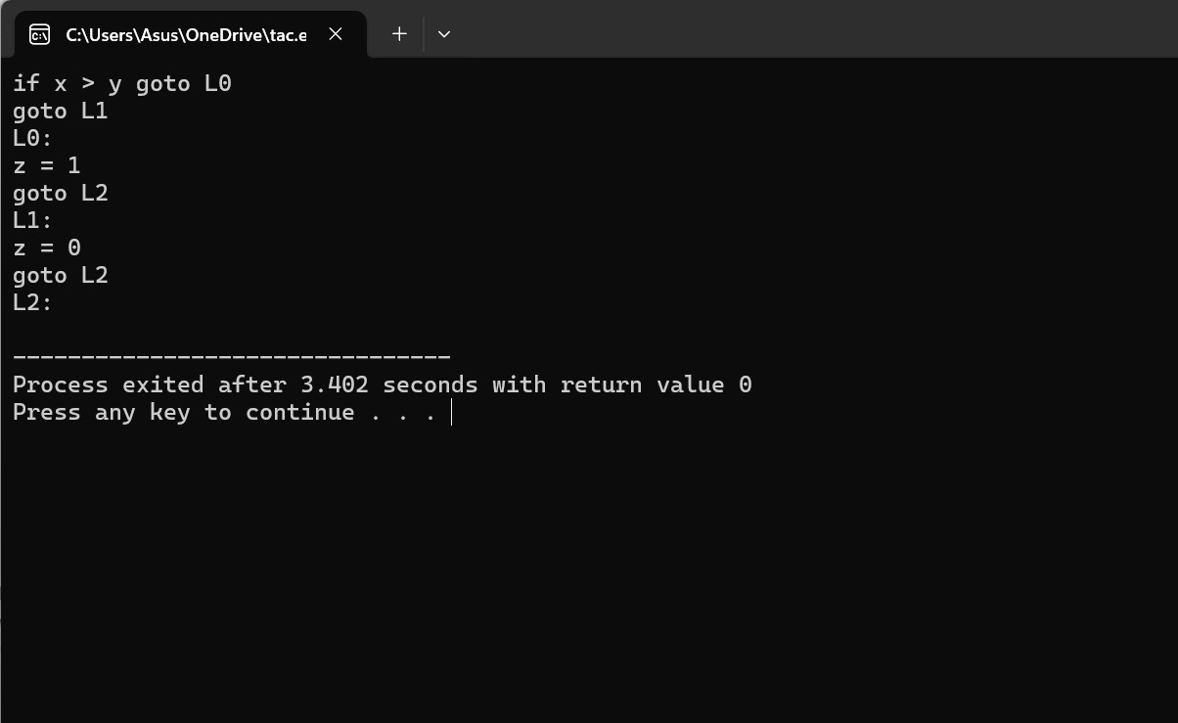

Slide 13
CONCLUSION:
In conclusion, this paper presents a systematic approach for generating three-address code representations tailored for control statements in programming languages.
By accurately capturing the semantics of control flow constructs, the proposed method enhances the utility of TAC for various compiler-related tasks. The experimental results demonstrate the effectiveness and efficiency of the method, indicating its potential for integration into modern compiler frameworks.
Overall, this contribution advances the understanding and manipulation of control flow in programs through the lens of three-address code.

